Slide 1


Database Migration
&
Validation Tool
reporter:Shen Xiyan WuZ iyou Yu Yuhan(leader)
Wang Jiahui Shen Entong Wang Xinyuan
time:2025/12/04
Notes:
Hello everyone! Today our team is delivering the project presentation for the PostgreSQL Database Migration and Validation Tool. The topic is "The Complete Record of Rust Migration Tool Delivery from 0 to 1".

Slide 2



CONTENTS
01
Project Initialization and Base Framework Setup
02
Log and Metadata Base Framework
03
CLI Dual Core: Create and Validation
04
Migration Execution and Rollback
05
Status Query and Web Migration
06
Front-end pages and joint debugging and end-to-end verification and delivery
07
Notes:
We will explain [the project] through 7 core parts.

Slide 3

01
Project Initialization
&
Base Framework Setup
Notes:
First, Part 1: Project Initialization—our base, done in 3 key steps.

Slide 4

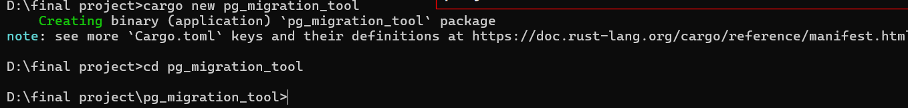
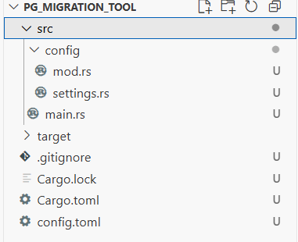


Create a project with cargo new
Command Execution
Project Structure
Verify the success of project initialization using the cargo build command. If the compilation completes without errors, it indicates that the project initialization is successful, laying the foundation for subsequent development.
Notes:
To start, we ran "cargo new pg_migration_tool" in the terminal. It creates a standard Rust structure for the team.

Slide 5
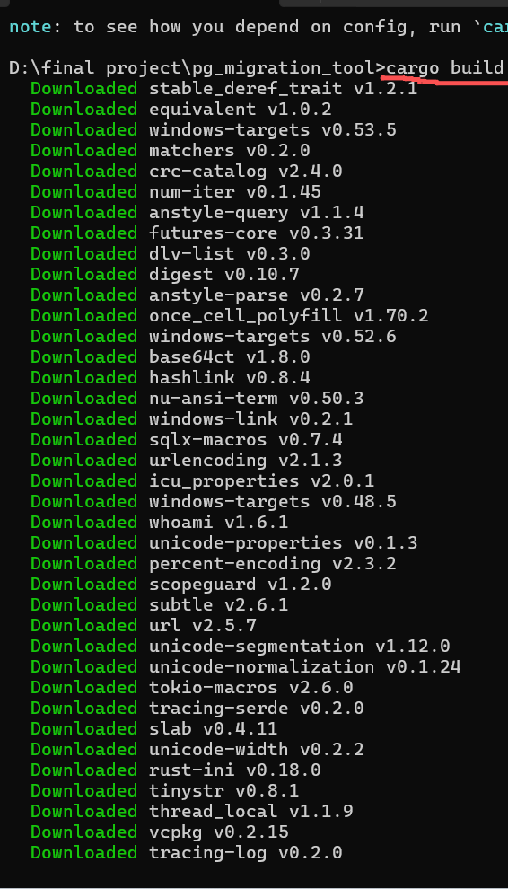
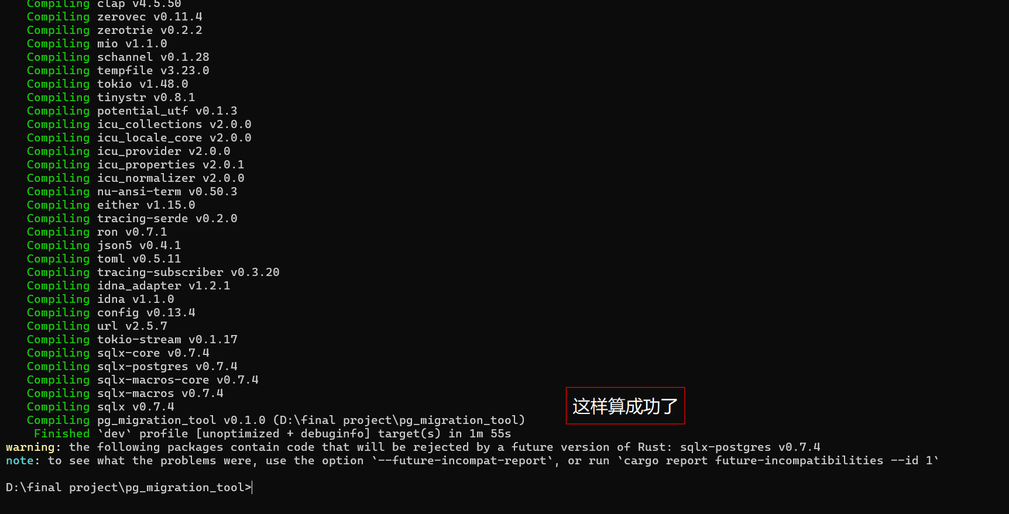
验证
Create a project with cargo new
Validation
Notes:
Next, we used "cargo build" to check—no errors, so the base environment works.

Slide 6
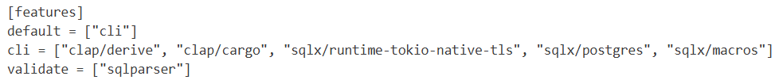

Set the default features to cli
Configure features
In Cargo.toml, configure the default features as cli, and place web-related dependencies under the web feature with it disabled by default. This can reduce the initial compilation time and optimize the development experience.
Notes:
Then, we configured Cargo.toml: default "cli" feature, web dependencies off by default to speed up compile time.

Slide 7
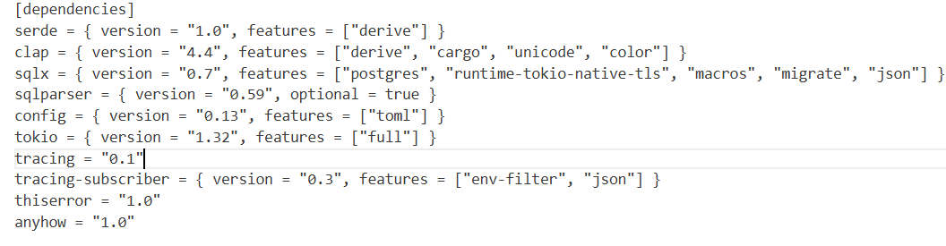
Introduce core dependencies in Cargo.toml
Add dependencies
Notes:
We also added key dependencies: serde, clap, sqlx, config, tokio, tracing—versions set to avoid conflicts.

Slide 8
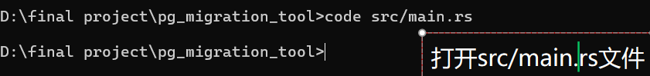

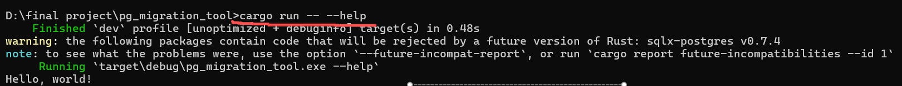
Smoke Test for Compilation Verification
Write test code
Check the output
Run and verify
Execute compilation
Run the cargo build command to verify whether the project can be compiled successfully.
Notes:
After that, a quick test: added "init complete" to main.rs, "cargo build" worked, and the program printed the message.

Slide 9

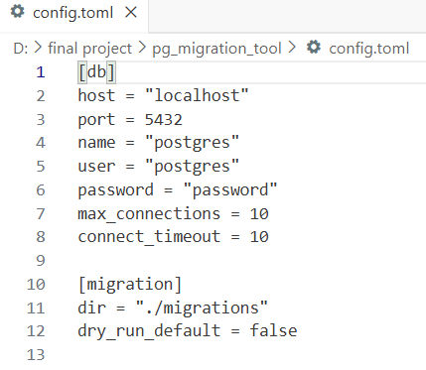
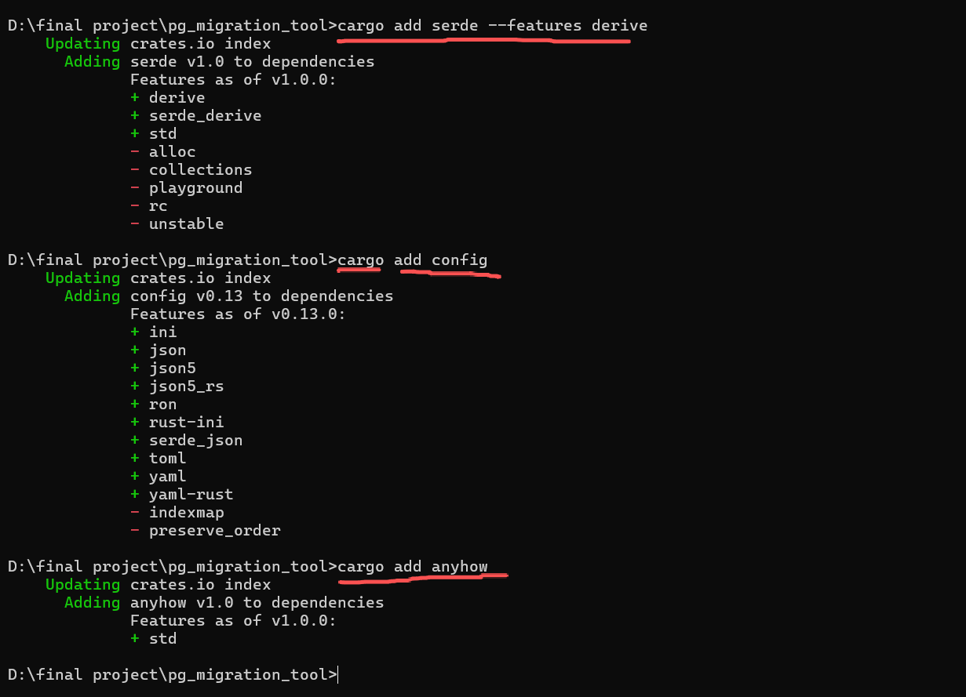
Define the Config struct
Struct definition
Serialization support
Field mapping
Notes:
Here’s the real "cargo build" output: built in ~2 mins, small warning, "cargo run -- --help" worked too.

Slide 10
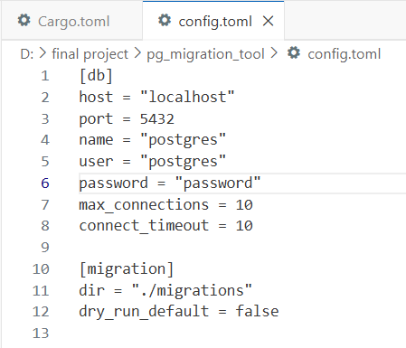
Write a config.toml template
Notes:
Now to config setup: in src/config.rs, we made a nested Config struct with serde_derive for TOML loading.

Slide 11
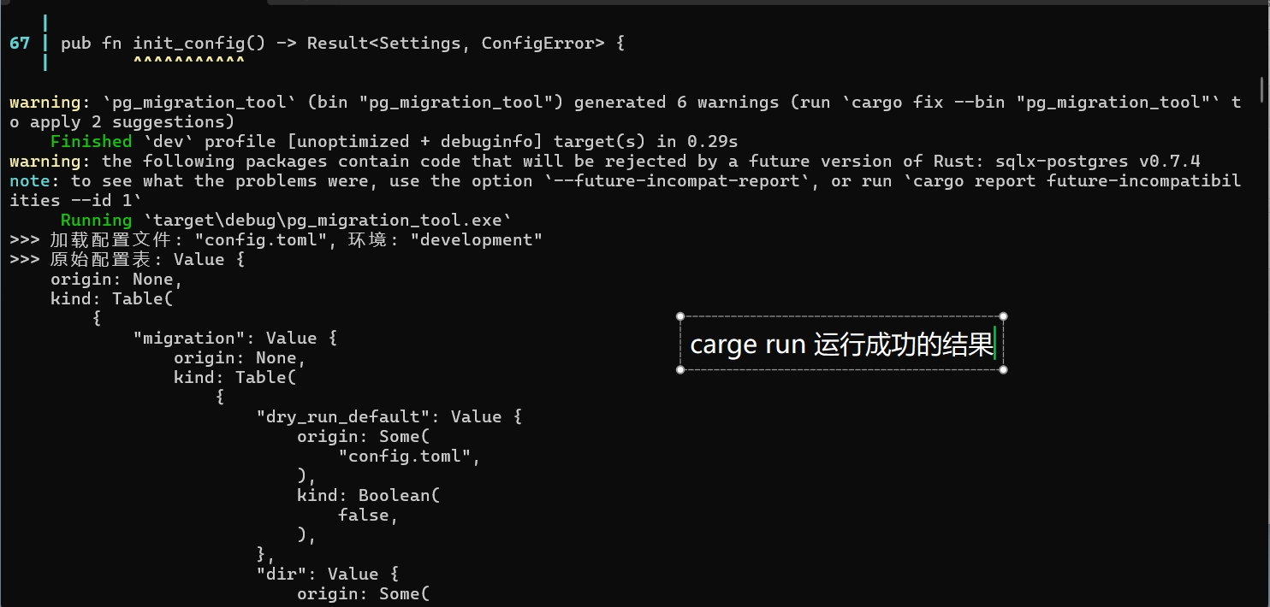
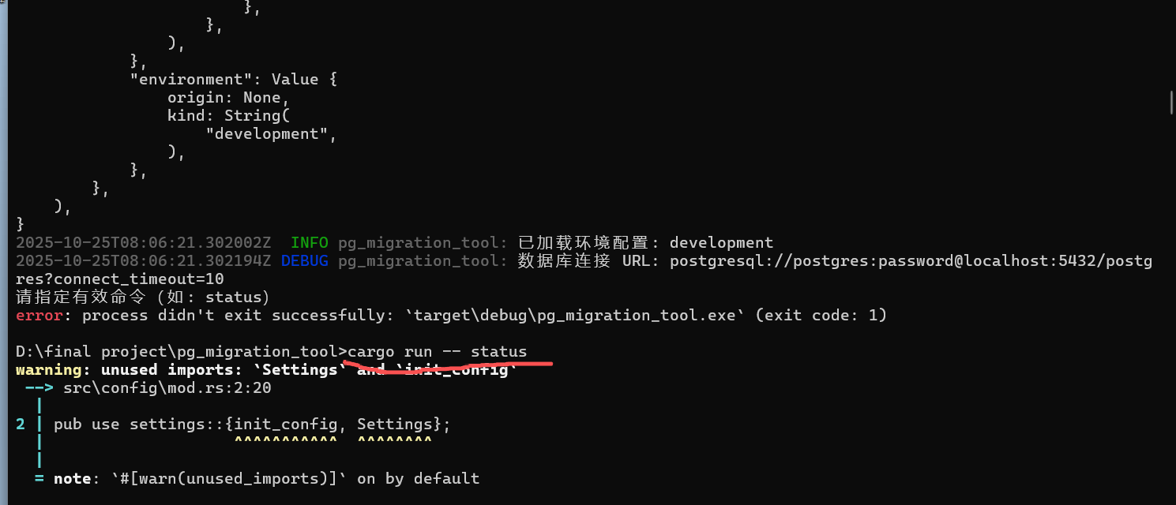
Implement the load_config function
Load the configuration
Notes:
We created a config.toml template and installed dependencies via terminal—all succeeded.

Slide 12
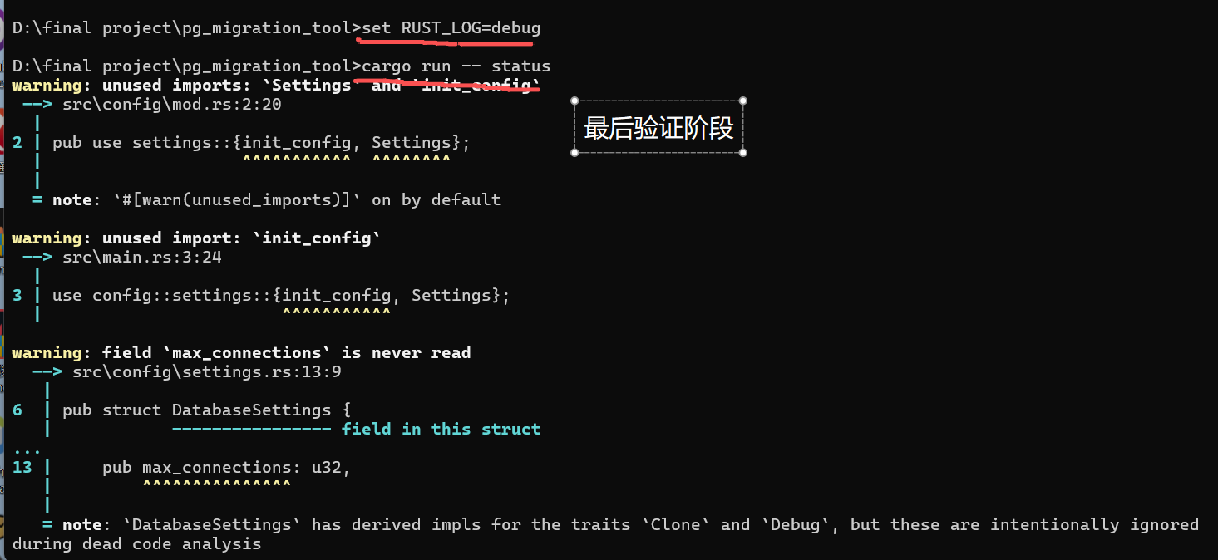
Verification
Final verification phase
Notes:
The config.toml is simple—team members can edit it easily, no extra docs needed.

Slide 13
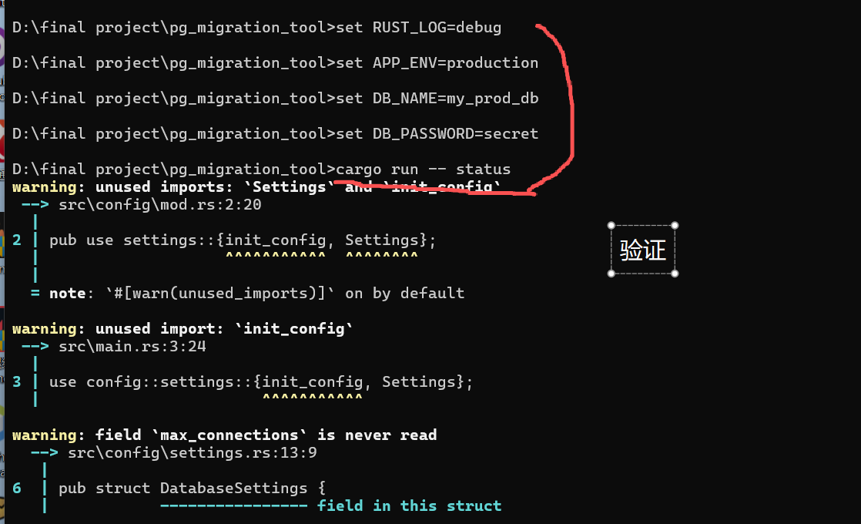
Verification
Final verification phase
Notes:
Next, we implemented load_config in src/config.rs: loads, parses config.toml, handles errors, returns Result.

Slide 14
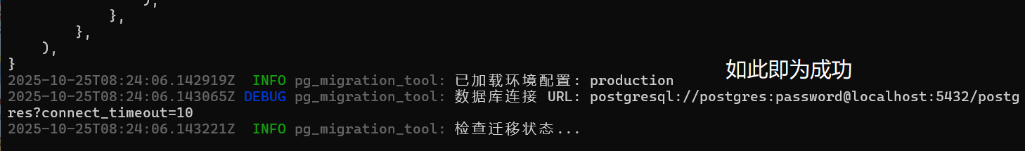
验证
This indicates success
Notes:
Finally, we tested load_config—warnings appeared but didn’t affect core functions, noted for fixes.

Slide 15
02
Log and metadata base
Notes:
Next, I’ll show you how building the PostgreSQL migration tool’s basic logging and metadata.

Slide 16

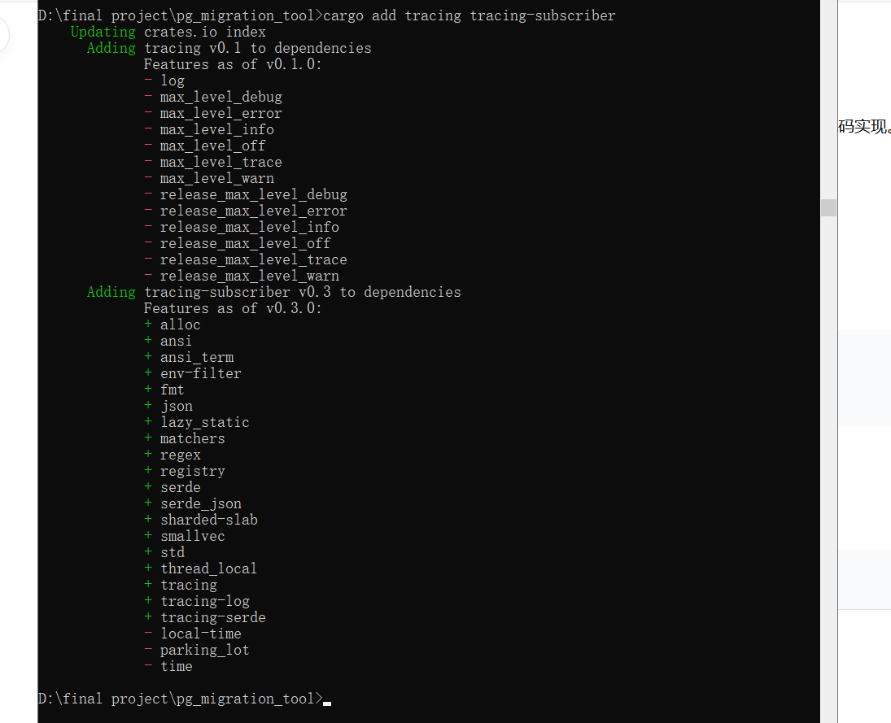
Add log dependencies
Operation: cargo add tracing-subscriber
Added tracing and tracing-subscriber dependencies
Notes:
The first step is to build a production-ready logging system , for runtime-adjustable log verbosity.

Slide 17
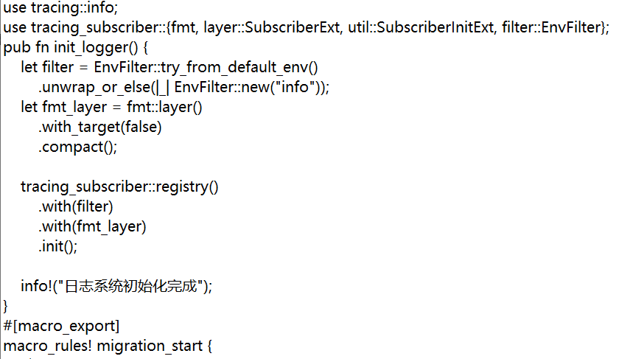
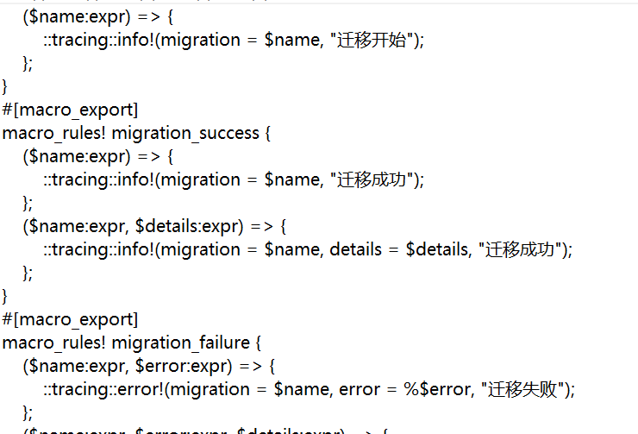
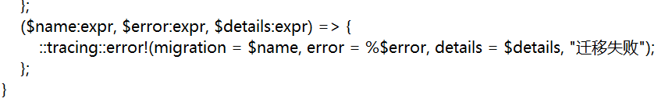
Create a log system module
Create a file:
src/logger.rs
The log system initialization function init_logger() has been implemented.
Three log macros were created
检查输出
检查终端输出，确认日志能够按照预期格式正确输出，无冗余信息。
Notes:
Step 2: Add 3 log types to the system. These structured logs capture context, details, and errors.

Slide 18
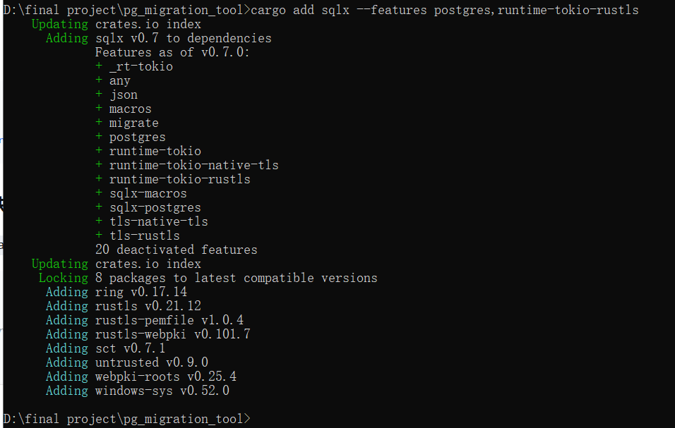

Add database dependencies
03
04
Operation: cargo add sqlx --features postgres,runtime -- tokio -- rustls
The SQLx asynchronous database tool has been added
状态字段
设计意图
引入status字段，支持失败可重试的场景，便于后续运维排查问题。
表结构设计旨在为迁移版本管理提供唯一真相源，满足项目对迁移过程的可追踪需求。
Notes:
Step 3: Add SQLx for data persistence. Benefits: safe, fast, smart data handling.

Slide 19
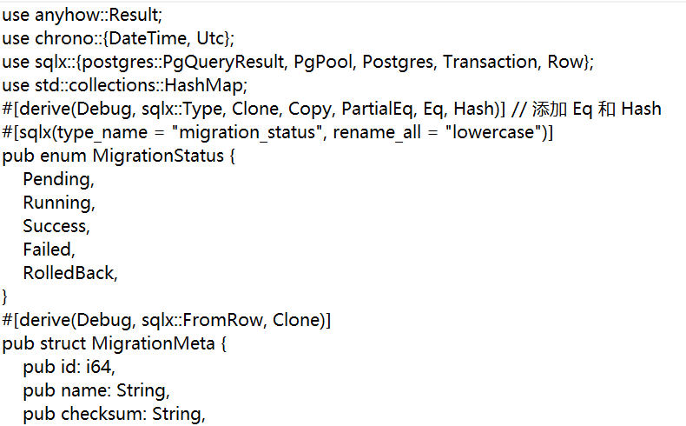

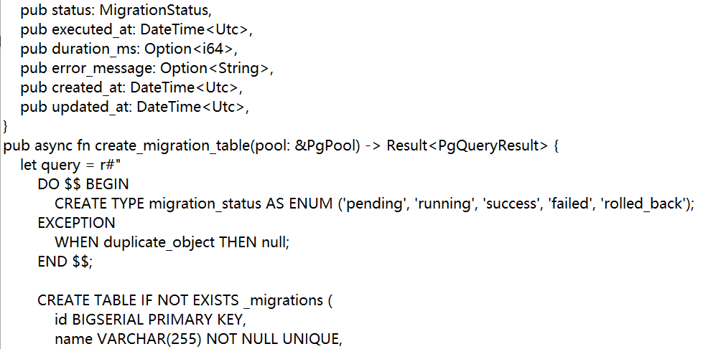
Create a metadata table module
File: src/migration_meta.rs
The MigrationStatus enumeration (Pending, Running, Success, Failed, RolledBack) was defined.
The MigrationMeta structure is defined to represent migration records
Notes:
Step 4: Build migration tracking via `src/migration_meta.rs`. Define a struct to store migration details.

Slide 20
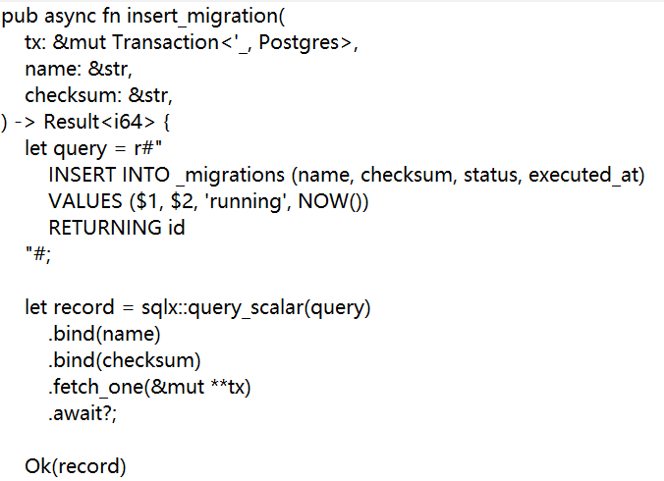
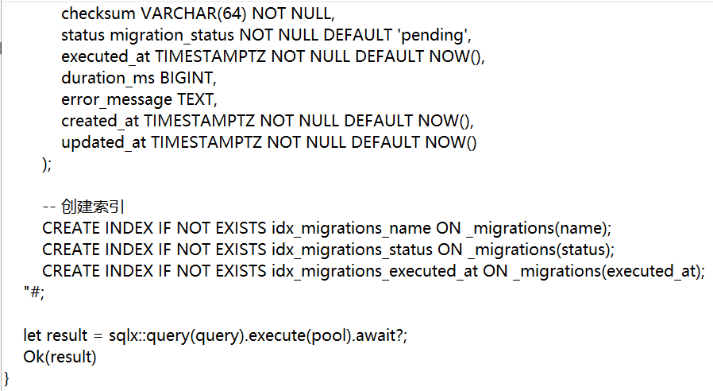
Create a metadata table module
Notes:
Then, we build five key functions around this:

Slide 21
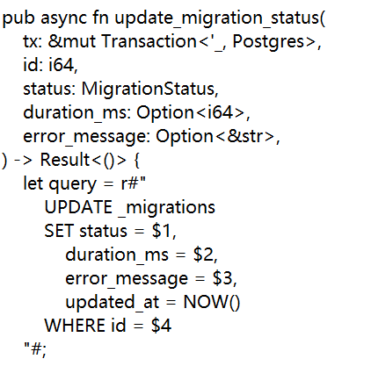
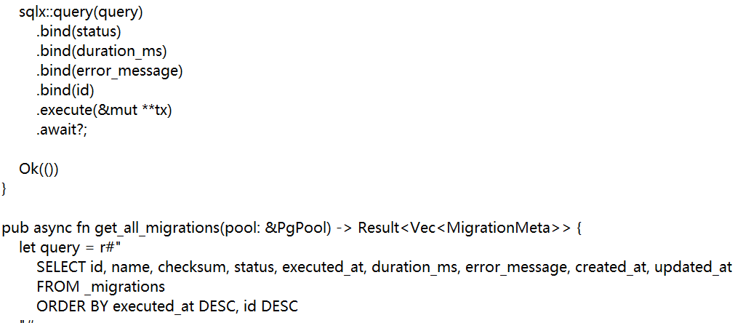
Create a metadata table module

Slide 22
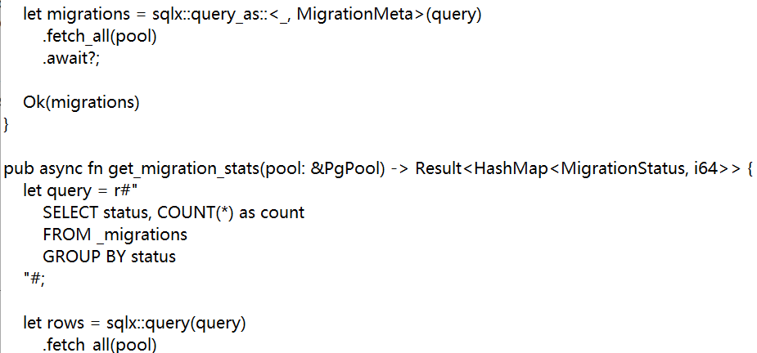
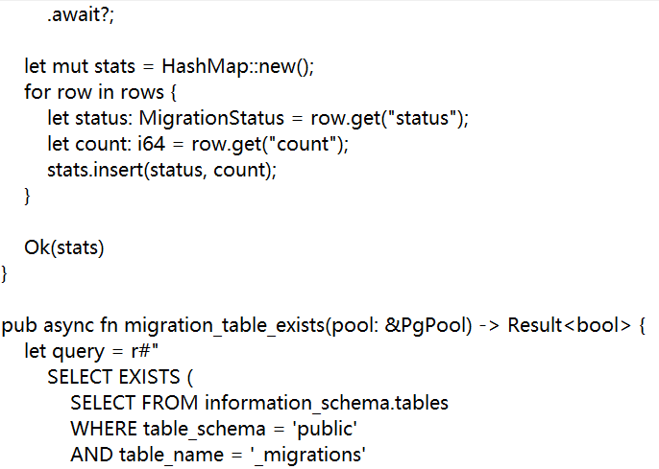
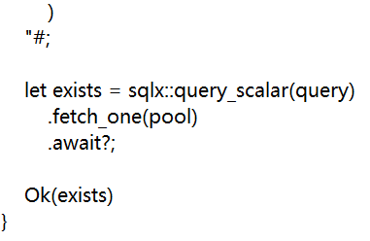
Create a metadata table module
Notes:
This whole system makes sure we know exactly what's happening with every data move, giving us full visibility and a clear history.

Slide 23

Configuration module structure
Create a file
Code：
pub mod settings;
pub use settings::{init_config, Settings};
src/config/mod.rs
A module structure has been established
Prepare for configuration management
Notes:
Step 5: Set up `src/config/mod.rs` (settings core). Centralize configs and build settings management incrementally.

Slide 24

Library module export
pub mod config;
pub mod logger;
pub mod migration_meta;
pub use logger::init_logger;
pub use migration_meta::{
create_migration_table, get_all_migrations, get_migration_stats, insert_migration,
migration_table_exists, update_migration_status, MigrationMeta, MigrationStatus,
};
Create a file ： src/lib.rs
All modules have been declared
The commonly used types and functions have been re-exported
This enables external crates to conveniently use these functions
Notes:
Step 6: Export via `src/lib.rs`—declare all modules and re-export common types and functions for external use.

Slide 25
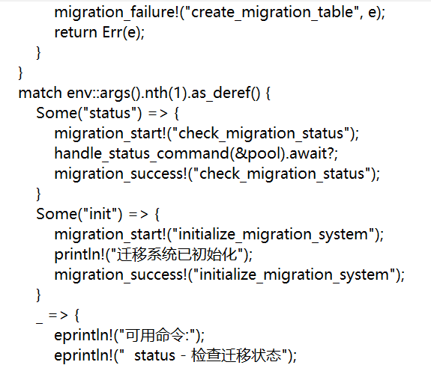
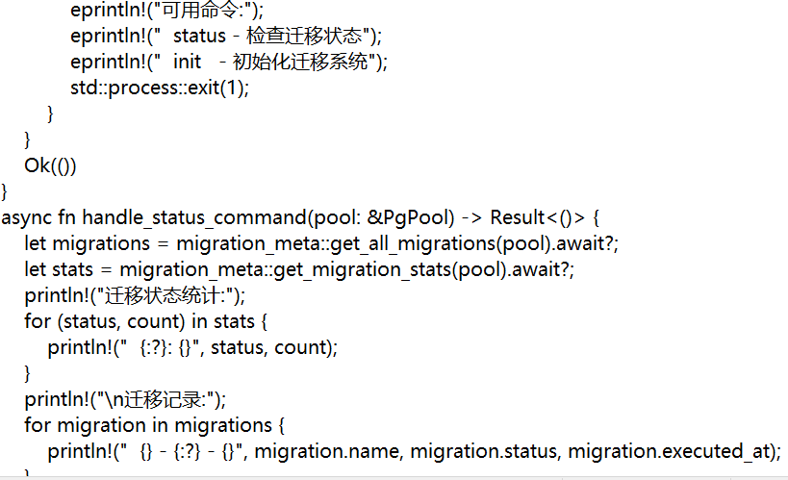
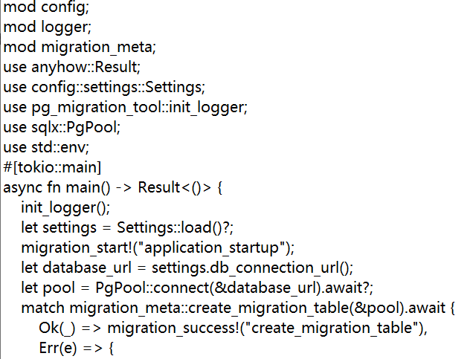
File: src/main.rs
Initialize the log system
Load the configuration, create a database connection pool, and create a migration metadata table
Handle command-line parameters (status, init commands)
Main program entry
Notes:
Step 7: Write `src/main.rs` to start components in order: logging → configs → DB connection pool → migration meta table + terminal command handling.

Slide 26
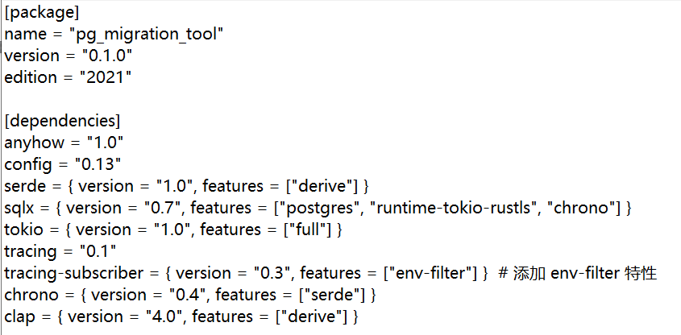
Update project configuration
File: Cargo.toml
All necessary dependencies have been added
Notes:
Step 8: Update Cargo.toml with required dependencies. Workspace fully set up.

Slide 27
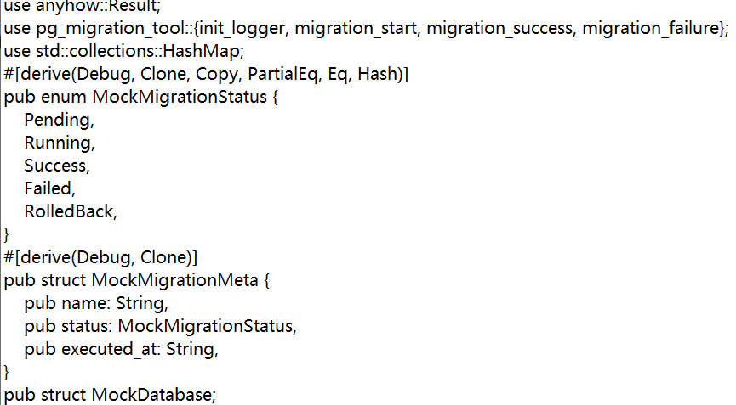
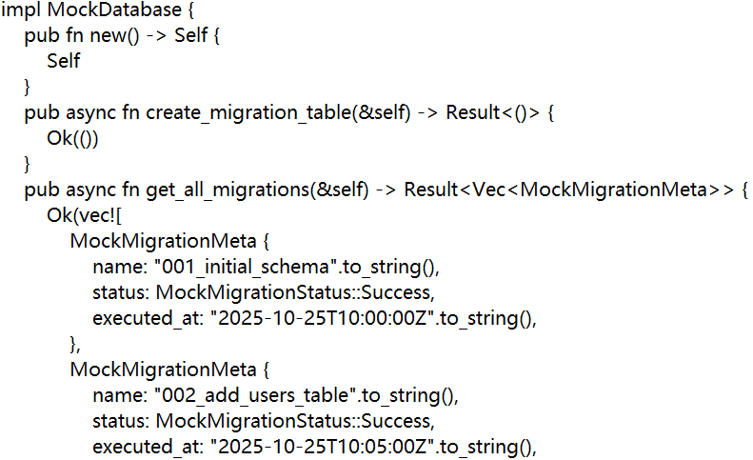
Verification procedure
Create a verification program module ：
src/verify_t3_t4.rs
Notes:
Finally, let's test everything to make sure it works.
We'll create a special testing file, src/verify_t3_t4.rs, to check our system from two main angles.

Slide 28
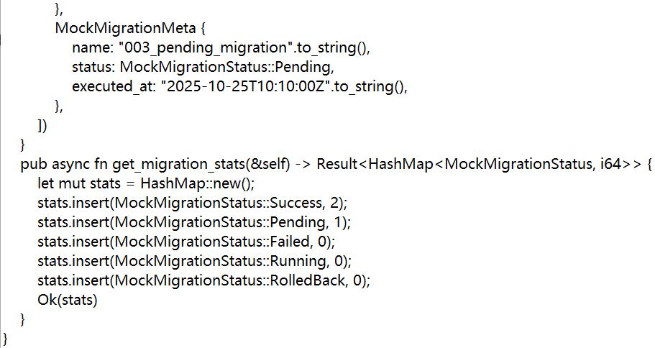
The T3 log function verification has been implemented
The functional verification of the T4 metadata table has been achieved
Notes:
Logging and Metadata tracking.

Slide 29
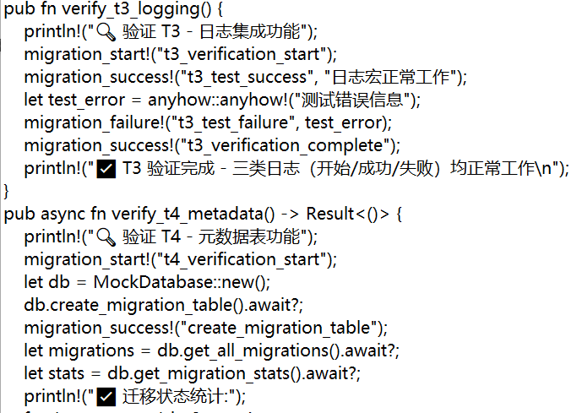
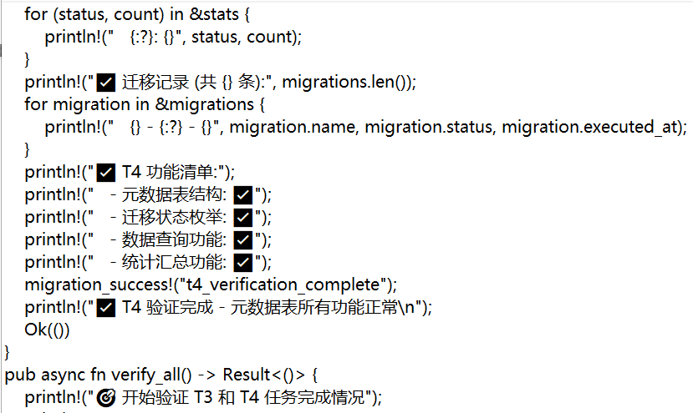
Verification procedure
Notes:
This whole testing routine is our final quality check, making sure every core part of the system does its job properly.

Slide 30
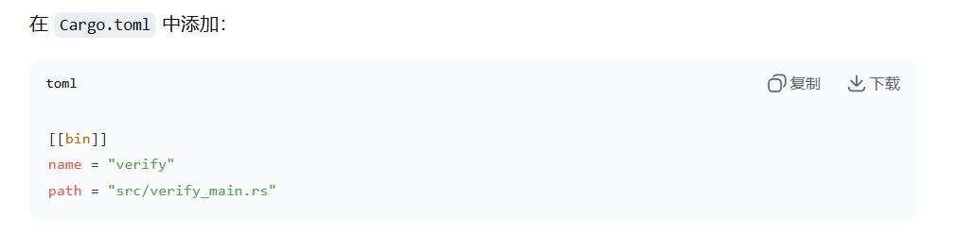
Configure binary targets
Operation: Add the [[bin]] configuration in Cargo.toml
An independent verification executable file has been created
Notes:
Create `src/verify_main.rs` for isolated tests

Slide 31
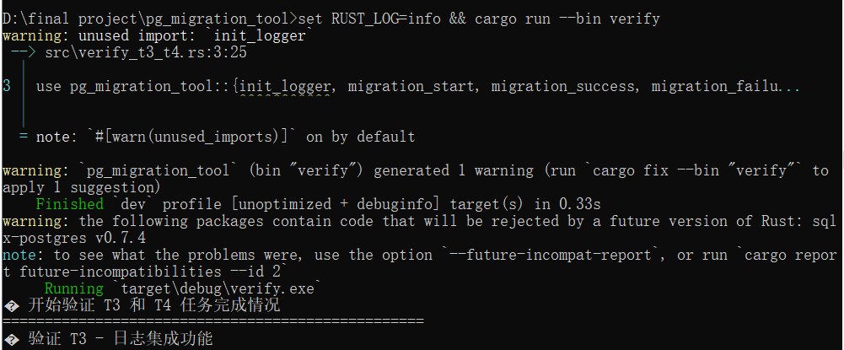
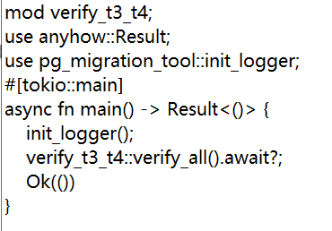
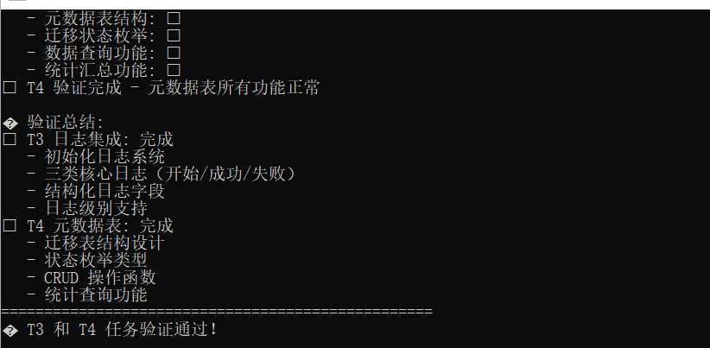
Verify the entry and results
The verification result shows：
Verify the program entry file ：
src/verify_main.rs
Notes:
The last picture shows us the test results.It means that the Log and metadata base has been set up.

Slide 32
03
CLI Dual-Core:
Create and Verification
Notes:
Hello everyone! I'm in charge of two core tasks. T5 creates timestamped SQL migration files with UP/DOWN templates based on clap v4; T6 achieves SQL syntax check and high-risk operation interception using sqlparser-rs, with flexible configuration.

Slide 33

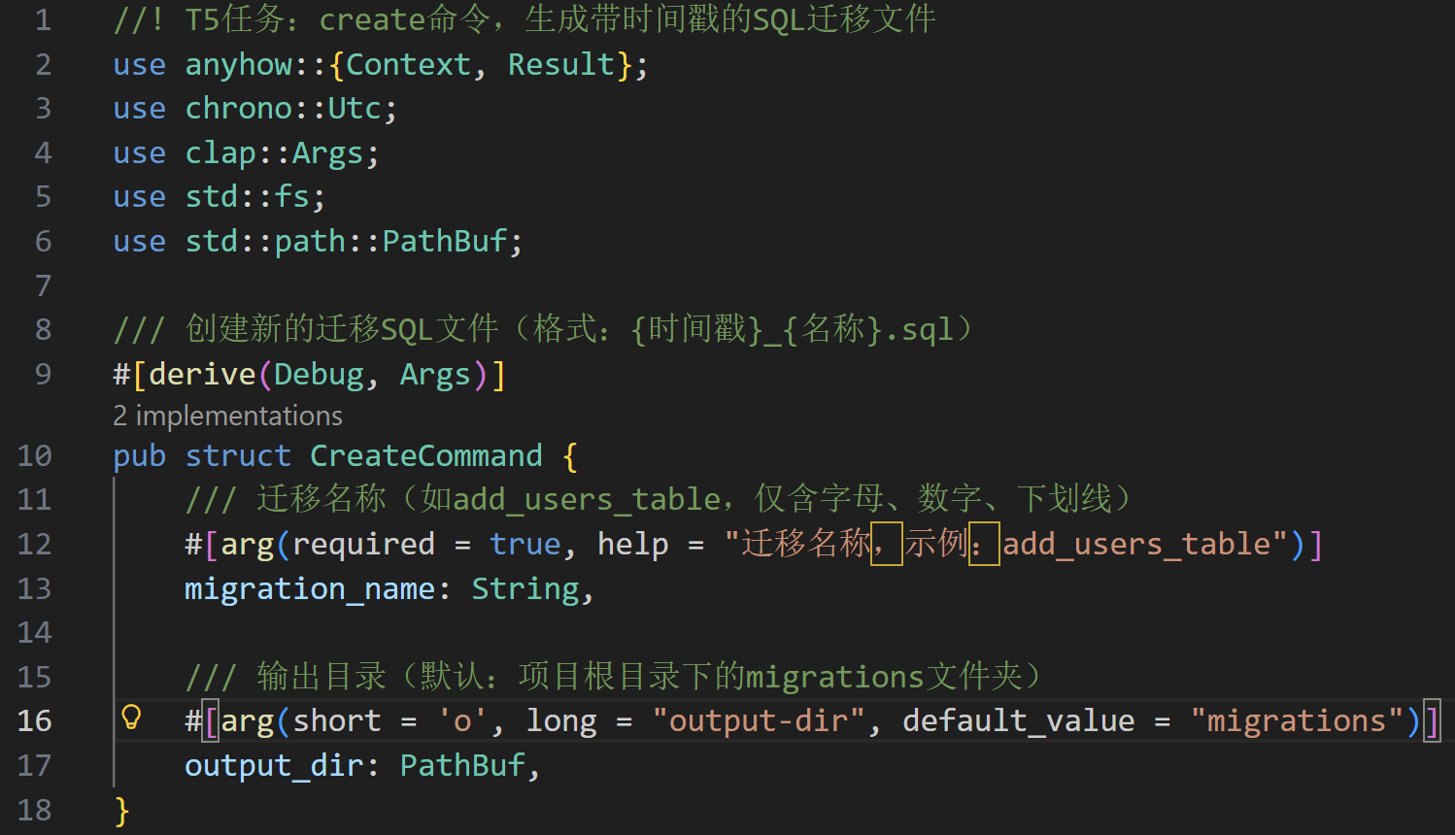
Define the Create.rs struct
CoreCore design of the struct (clap v4 command parameters)
Notes:
The core of T5 is the CreateCommand struct design. It has migration name and output directory parameters, ensuring regularity and flexibility.

Slide 34
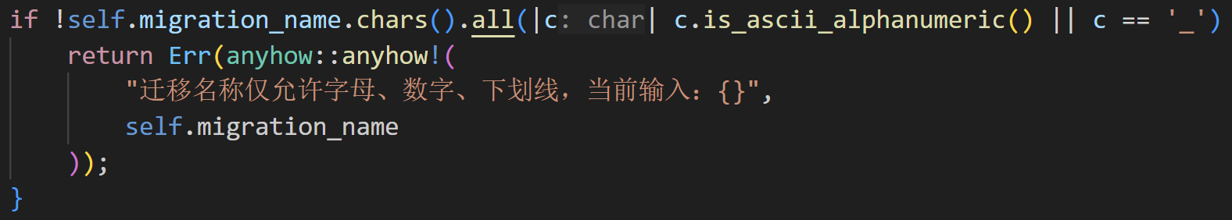
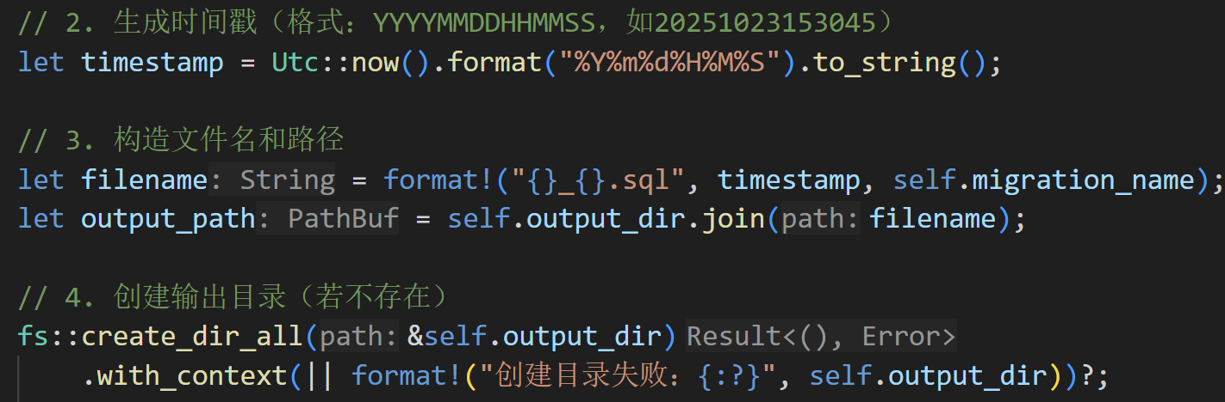
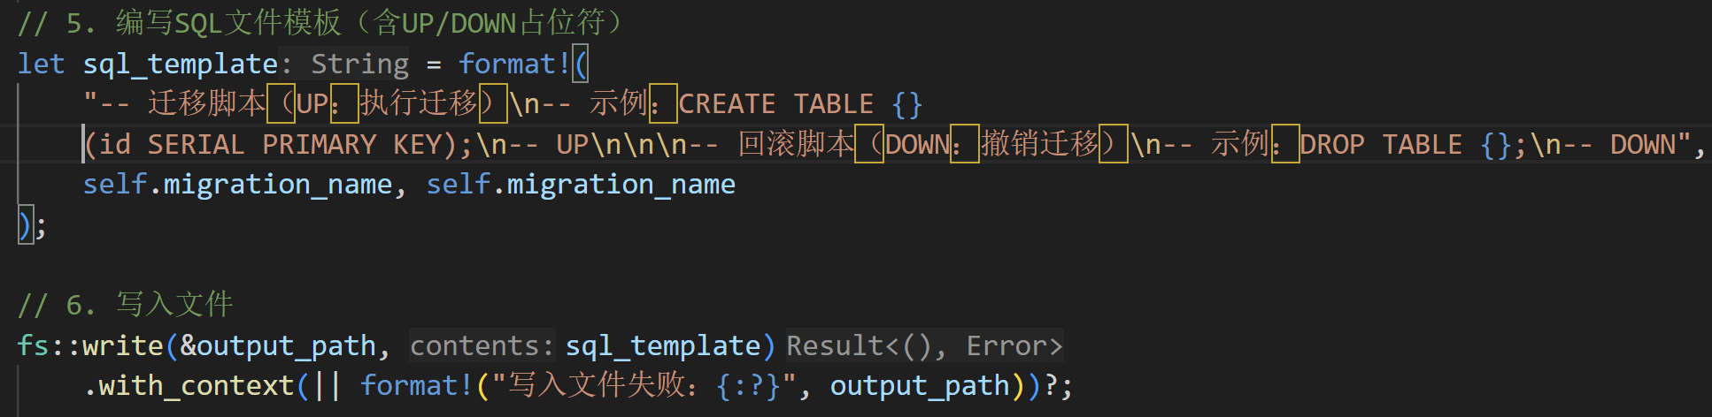
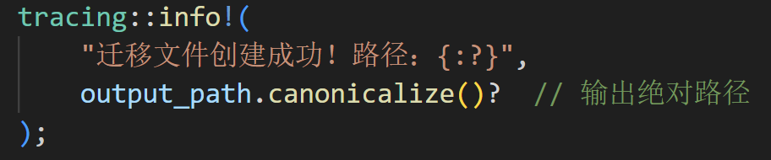
Core Logic (Core Steps of the run Method)
1.Name Validity Check
2.Timestamp and Path Generation
3.Built-in SQL Template Writing
4.Log Output
Notes:
The run method of create command has four steps: verify migration name format, generate unique timestamp, write UP/DOWN templates, build path and create directory.

Slide 35

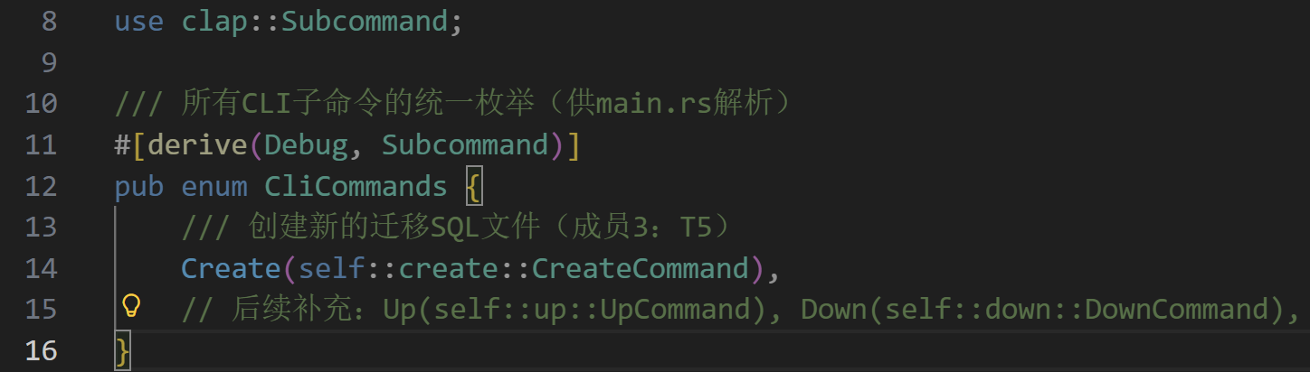
Project Integration: Command Registration and Executable Binary
Unified Subcommand Management (src/cli/mod.rs)
Notes:
After creating the create command, add it to the CliCommands enum in cli/mod.rs to realize management.

Slide 36
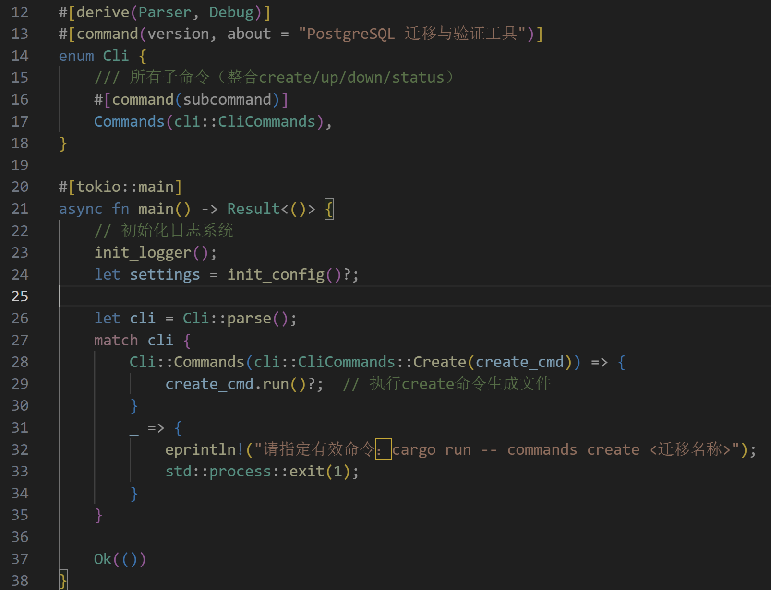
Entry Binding in main.rs
Notes:
Bind the command entry in main.rs. When users input cli create command, it can trigger the run method.

Slide 37


Configuration for Executable Binary (Cargo.toml)
Notes:
Configure default run target and binary output in Cargo.toml. It is more convenient to generate files after compilation.

Slide 38



Execution Effect and User Experience
Execution Effect and User Experience
Verification succeeded
Notes:
Run the create command to generate an SQL file, then check its details.

Slide 39


Example of Generated File
1.Path
2.Template Content
Notes:
The generated file follows the preset template. Users can quickly finish the script by replacing the content.

Slide 40



Core Dependencies and Interface Design
1. Key Dependencies (Cargo.toml)
Core Interface
1.Error Enumeration
2.Verify options
Notes:
T6 uses sqlparser-rs to adapt to PostgreSQL dialect, and thiserror to define custom errors. It designs ValidateOptions and ValidateError enum to distinguish error types.

Slide 41




Core Function Implementation
01
SQL Syntax Validation
Core Logic:
SQL Text →
Parse with PostgreSqlDialect →
Generate AST (Abstract Syntax Tree) →
Capture error if parsing fails and return ValidateError::SyntaxError
03
Notes:
Core logic of SQL syntax validation: Use PostgreSQL dialect, parse SQL into AST based on sqlparser-rs. Return syntax error if parsing fails; check high-risk operations if successful to avoid migration issues.

Slide 42

02
High-Risk Operation Interception
Interception Scope:
DROP TABLE：Delete table
DELETE FROM without WHERE：Full-table deletion
TRUNCATE TABLE：Truncate table
03
Notes:
T6 focuses on blocking three high-risk operations: DROP TABLE, DELETE without WHERE and TRUNCATE TABLE. It ensures data security.

Slide 43

Reusable Validation Function
Core Function Signature
The function is encapsulated under the SqlValidator struct and invoked via Self::, resulting in a more structured design.
validate_file automatically handles file reading and returns SyntaxError (including file reading error information) on failure.
Syntax validation is directly bound to PostgreSqlDialect without the need for additional parameters, adapting to the target database.
Notes:
The core logic of T6 is wrapped into the SqlValidator struct, which provides two functions: validate_file and validate_text. It is easy to use.

Slide 44
Test Case Coverage
Test Scenario | Corresponding Test Function | Expected Result
SQL with syntax error (missing parenthesis) | test_validate_syntax_error | Returns SyntaxError (containing "expected" or ")")
Normal SQL (CREATE TABLE) | test_validate_normal_sql | Validation passed (Ok(()))
High-risk operation (DROP TABLE) | test_validate_high_risk_drop | Returns HighRiskOp("DROP TABLE")
High-risk operation (DELETE without WHERE) | test_validate_high_risk_delete_no_where | Returns HighRiskOp("DELETE FROM (no WHERE clause, may delete entire table)")
High-risk operation (TRUNCATE TABLE) | (Extensible, code already supports detection) | Returns HighRiskOp("TRUNCATE TABLE")
Allowed specified high-risk operation (DROP TABLE) | test_validate_allowed_high_risk | Validation passed (Ok(()))
Disabled high-risk detection | test_validate_disabled_high_risk | High-risk operation allowed (Ok(()))
DELETE with WHERE clause (safe operation) | test_validate_delete_with_where | Validation passed (Ok(()))
Notes:
In order to ensure the accuracy of the function, I designed 7 core test cases to cover all key scenarios and clarify the expected results.

Slide 45



7 Tests
Notes:
Here are all 7 test cases that have passed.

Slide 46


All 7 core scenario tests have passed, indicating that:
The syntax validation module can accurately identify SQL syntax errors;
The high-risk operation interception logic can effectively block risky operations such as DROP TABLE and DELETE without WHERE;
Configuration items (allowing high-risk operations, disabling high-risk detection) can take effect as expected, meeting the flexible needs of different environments.
Usage Effect
Verification succeeded
Notes:
Both tasks have achieved. They support subsequent command development and ensure safe and standardized migration.

Slide 47
04
Migration Execution and Rollback
Notes:
Welcome to Phase 4: Migration Execution and Rollback. This is where our migration tool becomes truly production-ready, with a focus on safety, reversibility, and traceability.

Slide 48


Definition of Up and Parameters
Structure Definition
Parameter Analysis
Notes:
We start with Up migration. Users must explicitly specify the configuration file path—this prevents environment mismatches and ensures the right database is targeted.

Slide 49


Dry Run Transaction Simulation
Transaction Simulation
预检机制
Start a transaction within the same database connection, execute the SQL statements to be migrated in order, and if any statement fails, immediately roll back and return a detailed error.
Dryn机制让开发者在上迁前即可发现语法或约束问题，相当于为迁移脚本提供沙箱验证。
Verify the effect
Notes:
The core safety mechanism is Dry Run. It simulates all SQL in an isolated transaction. If any syntax errors or high-risk operations， it rolls back immediately and reports the error before anything real happens.

Slide 50



Official Migration and Metadata Storage
Transaction Binding
Pre-inspection and Execution
First, call dry_run for a pre-check. After passing, execute the same SQL formally using the same connection and commit the transaction to ensure atomicity.
Complete audit trail
Metadata record
Immediately after a successful migration, call the insert_record implemented by T4 to write version, name, status=success, and executed_at into the _migrations table.
Notes:
Once Dry Run passes, we proceed to formal execution. Execution and recording happen in the same transaction. After SQL succeeds, a success record is immediately written to the metadata table. This atomic design guarantees consistency, even if the system crashes.

Slide 51


Define DownCommand and steps
Structure Definition
Add the DownCommand struct in src/cli/down.rs, with steps defaulting to 1, allowing users to specify the rollback step count.
Check recent records
Notes:
Now, let’s talk about rollback. Our DownCommand defaults to rolling back one step, but users can specify multiple steps. It first queries the metadata table to find the most recent successful migration.

Slide 52


Reverse SQL Generation Rules
Data Backup
Before officially executing the reverse SQL, first call backup_table_to_csv to export all the data from the table to be deleted into a CSV file.
Reverse SQL Generation
Notes:
Instead of manual scripts, the system automatically parses the AST of the migration file and intelligently generates reverse SQL. This eliminates human error and speeds up operations.

Slide 53


CSV Backup and Transaction Rollback
Rollback execution
Transaction Security
If the reverse SQL fails,the CSV file will also be automatically cleaned up to avoid leaving a dirty backup.。
Status Tracking
Record the status and time of rollback operations through metadata tables to ensure that each rollback has a complete audit trail.
Lifecycle Management
Implement a bidirectional traceable migration lifecycle management to ensure that during multiple down/up combinations, the metadata table always accurately reflects the current database version.
Notes:
Before executing any DROP, we automatically export the full table data to a CSV backup. The entire rollback is wrapped in a transaction. On success, metadata updates to rolled_back.

Slide 54


UP failure interception demonstration
01
Prepare the script
Prepare a create table script with grammatical errors for testing the failure interception function of the up command.
Execute command
02
Execute `cargo run -- up --config config.toml` to verify whether the DryRun phase can correctly report errors and roll back.
03
Test Results
Check the database status, ensure no changes have occurred, and verify the effectiveness of the pre-check mechanism.
Notes:
Let’s see it in action. Here’s a script with a syntax error. When we run up, Dry Run immediately catches it, rolls back, and leaves the database untouched. This is how we prevent broken scripts from reaching production.

Slide 55


Down rollback backup demonstration
Perform rollback
Execute 'cargo run -- down --steps 1'. The system first exports the data from the test table to a CSV file, and then executes DROP TABLE.
生产适用性
Status Tracking
Check the _migrations table to ensure the status accurately reflects the rollback time and verify the reliability of the down command.
证明down命令在可恢复与可审计两方面均达到生产要求，为持续集成中的自动回滚场景提供可靠原语。
Notes:
Now, after a successful migration, we run down. Notice the system first backups the table to CSV, then executes the DROP, and finally updates the metadata.

Slide 56


Down rollback backup demonstration
生产适用性
证明down命令在可恢复与可审计两方面均达到生产要求，为持续集成中的自动回滚场景提供可靠原语。
Notes:
In summary, we’ve built a migration system that is safe through Dry Run, recoverable through CSV backups, and auditable through full metadata tracking. Thank you.

Slide 57
05
Status Query and Web Migration
Notes:
Good morning. I will walk you through Part 5: Status Query and Web Migration, where we extend the CLI tool with observability and a web-based operation interface.

Slide 58


Define the StatusCommand structure
Design of the StatusCommand Structure
• Simple config_path field configuration
• Maintain a consistent style with other CLI commands
• Zero-parameter design reduces the learning curve
Core query logic
• Connect to the database and read the migrations table
• Sort in descending order by version number
• Automatically calculate migration status
• Support for identifying applied/pending execution status
Notes:
We defined StatusCommand with just a config_path field, keeping it consistent and easy to use.
It connects to the database, reads migrations sorted by version, and automatically calculates status—showing what’s applied or pending.

Slide 59

Console four-column table output
Four column table output design
Version - Unique identifier
• Migration Name - Descriptive Name
• Status - Visual icon
• Execution time (Applied At) - timestamp
Status visualization icon
✅ Applied - Successfully executed
⏳ Pending - waiting for execution
❌ Failed - Execution failed
- Not executed - No time record
标记状态
通过集合对比，为每个版本打上已应用或待执行标签，直观展示迁移进度。
Notes:
Results are shown in a four-column table: Version, Name, Status with icons (✅ Applied, ⏳ Pending, ❌ Failed), and Execution Time.

Slide 60




Actix web service startup
Bind port 8080 service
Unified JSON response format
• Static file service support
Cross domain request processing
RESTful API Design
GET/app/migrations - Get migration status list
POST/app/migrations/up - Perform migration operations
Unified error handling mechanism
服务启动
Notes:
We launch an Actix-web service on port 8080 with JSON responses and CORS support.

Slide 61


GET/API/migrations reuse state logic
1. Start the web service
2. Call GET/app/migrations
3. Verify JSON response format
4. Data consistency check
Response data format
• success: whether the operation was successful
• data: Migration record array
• message: Status message
Notes:
We verify by: starting the service, calling the GET API, and checking the JSON response.
The response includes: success flag, data array, and a message.

Slide 62


Notes:
Here is a live API response example.

Slide 63

Front and rear data streams
🔗 Architectural Design
Front end: HTML+JavaScript
Backend: Rust+Actix web
Communication: RESTful API+JSON
Data flow: Front end → API → Back end → Database
接收参数
返回结果
POST /api/migrations/up接口接收JSON配置路径，解析后调用T7的up迁移内核。
将最终成功或失败原因封装为统一响应，包括executed_versions与error_detail字段。
执行迁移
测试集编写
执行dry run、正式执行、元数据记录完整链路，确保迁移操作的安全性和可靠性。
提供pg_migration_api.postman_collection.json，覆盖参数、预期响应、断言，方便使用Postman进行接口测试。
Notes:
The data flow is clear:
Frontend → API → Backend → Database → JSON → Frontend rendering.
This ensures a clean, maintainable system with real-time updates.

Slide 64


Front and rear data streams
🛠️ Backend technology stack
• Web framework: Actix web
• Routing configuration: manual registration
• Data serialization: Serde JSON
• Error handling: Result type
接收参数
返回结果
POST /api/migrations/up接口接收JSON配置路径，解析后调用T7的up迁移内核。
将最终成功或失败原因封装为统一响应，包括executed_versions与error_detail字段。
执行迁移
测试集编写
执行dry run、正式执行、元数据记录完整链路，确保迁移操作的安全性和可靠性。
提供pg_migration_api.postman_collection.json，覆盖参数、预期响应、断言，方便使用Postman进行接口测试。
Notes:
Our backend is built with Actix-web, using manual routing, Serde JSON for serialization, and Result types for error handling.

Slide 65

Front and rear data streams
🎨 Front-end design
• Native HTML/CSS/JavaScript
• Responsive table design
Real time status display
• User interaction buttons
接收参数
返回结果
POST /api/migrations/up接口接收JSON配置路径，解析后调用T7的up迁移内核。
将最终成功或失败原因封装为统一响应，包括executed_versions与error_detail字段。
执行迁移
测试集编写
执行dry run、正式执行、元数据记录完整链路，确保迁移操作的安全性和可靠性。
提供pg_migration_api.postman_collection.json，覆盖参数、预期响应、断言，方便使用Postman进行接口测试。
Notes:
The frontend is built with native HTML, CSS, and JavaScript, featuring a responsive table and real-time status display with user interaction buttons.

Slide 66

Front and rear data streams
✅ Connection verification
Curl testing API usability
Browser developer tool monitoring
Real time request response logs
• Error handling and downgrade
接收参数
返回结果
POST /api/migrations/up接口接收JSON配置路径，解析后调用T7的up迁移内核。
将最终成功或失败原因封装为统一响应，包括executed_versions与error_detail字段。
执行迁移
测试集编写
执行dry run、正式执行、元数据记录完整链路，确保迁移操作的安全性和可靠性。
提供pg_migration_api.postman_collection.json，覆盖参数、预期响应、断言，方便使用Postman进行接口测试。
Notes:
We verify connectivity using curl tests, browser dev tools, and real-time logs, with built-in error handling and graceful degradation.

Slide 67

Notes:
For POST /api/migrations/up, we handle migration execution and return a success response in the same unified JSON format, ensuring consistency and clarity for the frontend.

Slide 68

Front and rear data streams
🚀 operating procedure
1. Page loading automatically retrieves data
2. Display migration status table
3. User clicks to execute migration
4. Backend processing and returning results
5. Front end refresh displays new status
接收参数
返回结果
POST /api/migrations/up接口接收JSON配置路径，解析后调用T7的up迁移内核。
将最终成功或失败原因封装为统一响应，包括executed_versions与error_detail字段。
执行迁移
测试集编写
执行dry run、正式执行、元数据记录完整链路，确保迁移操作的安全性和可靠性。
提供pg_migration_api.postman_collection.json，覆盖参数、预期响应、断言，方便使用Postman进行接口测试。
Notes:
The operating procedure is straightforward:
Page loads data → displays the table → user clicks to execute → backend processes → frontend refreshes status.

Slide 69


接收参数
返回结果
POST /api/migrations/up接口接收JSON配置路径，解析后调用T7的up迁移内核。
将最终成功或失败原因封装为统一响应，包括executed_versions与error_detail字段。
执行迁移
测试集编写
执行dry run、正式执行、元数据记录完整链路，确保迁移操作的安全性和可靠性。
提供pg_migration_api.postman_collection.json，覆盖参数、预期响应、断言，方便使用Postman进行接口测试。
Notes:
Here is our frontend implementation. The renderTable function dynamically builds the status table

Slide 70

HTML List Page Structure Design
Notes:
Here is our final dashboard. It clearly displays migration status with visual indicators: a checkmark for applied, a cross for pending. You can execute migrations or refresh status directly from this interface.

Slide 71
06
Front-end pages and joint debugging and end-to-end verification and delivery

Slide 72



Static file routing mounts
Routing configuration
Configure static file routing in Actix-web service to map local static directories to /static prefixes to facilitate browsers to directly access HTML and JS files.

Slide 73


Cross-domain response header processing
Cross-domain issues
Add Access-Control-Allow-Origin:* to the response header to allow local file protocol or cross-port debugging.
Workaround
Ensure that the front-end and back-end joint debugging will not be blocked by the browser due to cross-domain issues.

Slide 74



test_full_flow.sh scripting
01
02
03
Script orchestration
Key Point Verification
Test Report
Write test_full_flow.sh script and call the create, up, status, and down commands in order, and assert success through the exit code at each step.
Use cURL to access the status API to confirm key nodes such as SQL generation, table creation success, and disappearance after rollback.
After the script is executed, the test report .md is automatically generated, including command, expectation, actual, and screenshot columns, and the evidence is solidified in the form of a table.

Slide 75



Run the test results

Slide 76
THANK YOU FOR WATCHING
Notes:
Thank you for your listening.

